Slide 1
CEG4424/6424 Security Attacks and Defenses Risk Management
This lecture slide is mainly based on the power point slides by Professor Lawrie Brown.

Slide 2
Overview
security requirements means asking
what assets do we need to protect?
how are those assets threatened?
what can we do to counter those threats?
IT security management answers these
determining security objectives and risk profile
perform security risk assessment of assets
select, implement, monitor controls
Notes:
Now look at the process of how to best select and implement measures to effectively address an organization’s security requirements. This involves examining three fundamental questions:
What assets do we need to protect?
How are those assets threatened?
What can we do to counter those threats?
IT security management is the formal process of answering these questions, ensuring that critical assets are sufficiently protected in a cost effective manner. More specifically, IT security management consists of firstly determining a clear view of an organization’s IT security objectives and general risk profile. Next an IT security risk assessment is needed for each asset in the organization that requires protection to answer the three key questions listed above. This provides the information necessary to decide what management, operational and technical controls are needed to reduce the risks identified to an acceptable level, eliminate them, or to provide mitigating controls. The process continues by selecting suitable controls, and then writing plans and procedures to ensure these necessary controls are effectively implemented. The whole process must be iterated, and the plans and procedures kept up-to-date, because of the rapid rate of change in both the technology and the risk environment. We discuss the latter part of this process in the next chapter.

Slide 3
IT Security Management
IT Security Management: a process used to achieve and maintain appropriate levels of confidentiality, integrity, availability, accountability, authenticity and reliability. IT security management functions include:
• organizational IT security objectives, strategies and policies
• determining organizational IT security requirements
• identifying and analyzing security threats to IT assets
• identifying and analyzing risks
• specifying appropriate safeguards
• monitoring the implementation and operation of safeguards
• developing and implement a security awareness program
• detecting and reacting to incidents
Notes:
The discipline of IT security management has evolved considerably over the last few decades. [ISO13335] provides a conceptual framework for managing security. It defines IT Security Management as shown on this slide.

Slide 4
ISO 27000 Security Standards
ISO: International Organization for Standardization
Subcommittee 27: meet twice every year.
Notes:
In the last decade a number of national and international standards have been published. These represent a consensus on the “best practice” in the field. The International Standards Organization (ISO) is currently revising and consolidating a number of these standards into the “ISO 27000 series”. Table 16.1 in the text details a number of existing and proposed standards associated with this family. In the US, NIST has produced a number of relevant standards, including [NIST02], [NIST05] and [NIST06]. With the growth of concerns about corporate governance following events such as the Enron collapse, and repeated incidences of the loss of personal information by government organizations, auditors for such organizations increasingly request adherence to formal standards such as these.

Slide 5
ISO 27000 Security Standards
Definitions of basic terminology
Descriptions of Operations of ISMS (Information Security Management Systems)
Security Controls
Risk Assessment
System Audit
Notes:
In the last decade a number of national and international standards have been published. These represent a consensus on the “best practice” in the field. The International Standards Organization (ISO) is currently revising and consolidating a number of these standards into the “ISO 27000 series”. Table 16.1 in the text details a number of existing and proposed standards associated with this family. In the US, NIST has produced a number of relevant standards, including [NIST02], [NIST05] and [NIST06]. With the growth of concerns about corporate governance following events such as the Enron collapse, and repeated incidences of the loss of personal information by government organizations, auditors for such organizations increasingly request adherence to formal standards such as these.

Slide 6
ISO 27000 Security Standards
Definitions –ISO 27000
Requirements –ISO 27001, ISO 27006, ISO 27009
ISO 27000: Security Compliance of ISMS
ISO 27006: Audit and Certification of ISMS
ISO 27009: Addition Requirements for Specific Sectors
Guidelines –ISO 27002, ISO 27003, ISO 27004, ISO 27005, ISO 27007
ISO 27013, ISO 27014
27005: Risk Management
Sector Specific –ISO 27010, ISO 27011, ISO 27015, ISO 27017, ISO27018
ISO 27019
Financial services, cloud services
Control Specific –ISO 2703x, ISO 2704x
ISO/IEC committee 1– subcommittee 27
IEC (International Electrotechnical Commission)
Certification against 27001
Notes:
In the last decade a number of national and international standards have been published. These represent a consensus on the “best practice” in the field. The International Standards Organization (ISO) is currently revising and consolidating a number of these standards into the “ISO 27000 series”. Table 16.1 in the text details a number of existing and proposed standards associated with this family. In the US, NIST has produced a number of relevant standards, including [NIST02], [NIST05] and [NIST06]. With the growth of concerns about corporate governance following events such as the Enron collapse, and repeated incidences of the loss of personal information by government organizations, auditors for such organizations increasingly request adherence to formal standards such as these.

Slide 7
NIST Risk Management
NIST SP 800-37 Rev. 2
Risk Management Framework for Information Systems and Organizations: A System Life Cycle Approach for Security and Privacy
NIST SP 800-30 Rev. 1
Guide for Conducting Risk Assessments
NIST SP 800-53 Rev. 5
Security and Privacy Controls for Information Systems and Organizations
NIST SP 800-61
Incident Response Recommendations and Considerations for Cybersecurity Risk Management
NIST SP 800-171 Rev. 2
Protecting Controlled Unclassified Information in Nonfederal Systems and Organizations
Notes:
In the last decade a number of national and international standards have been published. These represent a consensus on the “best practice” in the field. The International Standards Organization (ISO) is currently revising and consolidating a number of these standards into the “ISO 27000 series”. Table 16.1 in the text details a number of existing and proposed standards associated with this family. In the US, NIST has produced a number of relevant standards, including [NIST02], [NIST05] and [NIST06]. With the growth of concerns about corporate governance following events such as the Enron collapse, and repeated incidences of the loss of personal information by government organizations, auditors for such organizations increasingly request adherence to formal standards such as these.

Slide 8
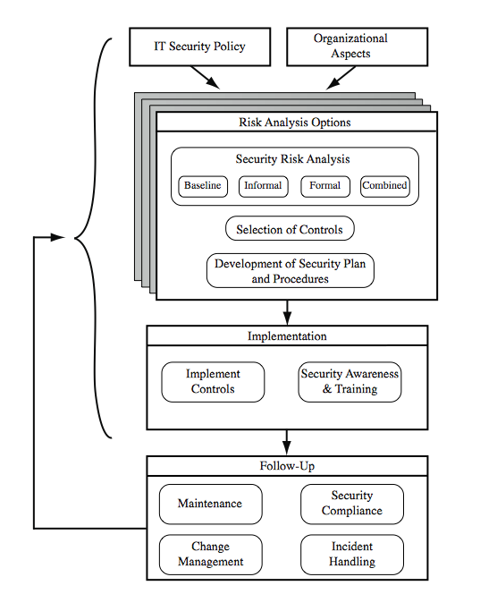
IT Security Management Process
Notes:
The IT security management process is illustrated in Figure 16.1 of the text (based on [ISO13335]), with a particular focus on the internal details relating to the risk assessment process. It is important to emphasize that IT security management needs to be a key part of an organization’s overall management plan. Similarly, the IT security risk assessment process should be incorporated into the wider risk assessment of all the organization’s assets and business processes. Hence, unless senior management in an organization are aware of, and support, this process, it is unlikely that the desired security objectives will be met and contribute appropriately to the organization’s business outcomes. Note also that IT management is not something undertaken just once. Rather it is a cyclic process that must be repeated constantly in order to keep pace with the rapid changes both in IT technology and the risk environment.

Slide 9
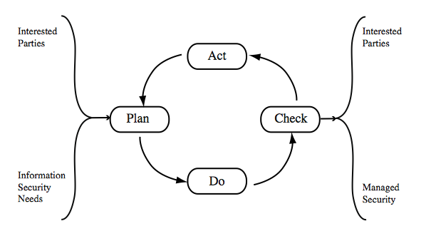
ISO 27003 :Plan - Do - Check – Act
take corrective and
preventative actions
(based on audits)
establish policy; define
objectives and processes
assess and measure
and report results
implement and operate
policy, controls, processes
Notes:
The iterative nature of this process is a key focus of [ISO27001], and is illustrated in Figure 16.2 (from [ISO27001]) in the text. This standard details a model process for managing information security that comprises the following steps:
Plan - establish security policy, objectives, processes and procedures relevant to managing risk and improving information security to deliver results in accordance with an organization’s overall policies and objectives.
Do - implement and operate the security policy, controls, processes and procedures.
Check - assess and, where applicable, measure process performance against security policy, objectives and practical experience and report the results to management for review.
Act - take corrective and preventive actions, based on the results of the internal security audit and management review or other relevant information, to achieve continual improvement of the security management process.
Compare this figure with that on the previous slide. The development of the organization’s IT security objectives, strategies and policies, the risk assessment, and the development of an IT security plan all clearly constitute the “plan” stage of this process. The implementation aspects constitute the “do” stage. The follow up forms the “check” stage. Lastly, the feedback of details from the follow up aspects to all earlier stages in the process comprises the “act” stage of this model. The outcome of this process should be that the security needs of the interested parties are managed appropriately.

Slide 10
Organizational Context and Security Policy
first examine organization’s IT security:
objectives - wanted IT security outcomes
strategies - how to meet objectives
policies - identify what needs to be done
maintained and updated regularly
using periodic security reviews
reflect changing technical/risk environments
Notes:
The initial step in the IT security management process comprises an examination of the organization’s IT security objectives, strategies and policies, in the context of the organization’s general risk profile. Organizational security objectives identify what IT security outcomes should be achieved. They need to address individual rights, legal requirements and standards imposed on the organization, in support of the overall organizational objectives. Organizational security strategies identify how these objectives can be met. Organizational security policies identify what needs to be done. These objectives, strategies and policies need to be maintained and regularly updated based on the results of periodic security reviews, to reflect the constantly changing technological and risk environments. To help identify these organizational security objectives, the role and importance of the IT systems in the organization is examined. The value of these systems in assisting the organization achieve its goals is reviewed, not just the direct costs of these systems.

Slide 11
Security Policy: Topics to Cover
Security Policy: Security rules to keep the organization secure
Specific rules
Organization Specific
Security Policy needs to address:
scope and purpose including relation of objectives to business, legal, regulatory requirements
IT security requirements
assignment of responsibilities
risk management approach
security awareness and training
general personnel issues and any legal sanctions
integration of security into systems development
information classification scheme
contingency and business continuity planning
incident detection and handling processes
how when policy reviewed, and change control to it
Notes:
The organizational security policy describes what the objectives and strategies are, and the process used to achieve them. The intent of the policy is to provide a clear overview of how an organization’s IT infrastructure supports its overall business objectives in general, and more specifically what security requirements must provided in order to do this most effectively. The organizational or corporate security policy may be either a single large document, or more commonly a set of related documents. This policy typically needs to address at least the following topics:
• the scope and purpose of the policy
• the relationship of the security objectives to the organization’s legal and regulatory obligations, and its business objectives
• IT security requirements in terms of confidentiality, integrity, availability, accountability, authenticity and reliability, with regard to views of asset owners
the assignment of responsibilities relating to the management of IT security
the risk management approach adopted by the organization
• how security awareness and training is to be handled
• general personnel issues, especially for those in positions of trust, and any legal sanctions that may be imposed on staff, and the conditions when apply
• integration of security into systems development and procurement
• definition of the information classification scheme used across the organization
• contingency and business continuity planning, incident detection and handling
• how and when it is reviewed and method for controlling changes to it

Slide 12
Security Policy: Topics to Cover
Topics
Access Control
Information Classificaton
Physical Security
Acceptable Use
Information Transfer
Bring your own device
Software installation
Factors
Size (International Organization with 10000 employees, or small company with 50 employees
Culture
Business Goals
Law
Notes:
Security Policies are usually within an organization
Security Standards are beyond an organization.

Slide 13
Management Support
IT security policy must be supported by senior management
need IT security officer
to provide consistent overall supervision
manage process
handle incidents
large organizations needs IT security officers on major projects/teams
manage process within their areas
Notes:
It is critical that the IT security policy has full approval and buy-in by senior management. Without this, experience shows that it is unlikely sufficient resources or emphasis will be given to meeting the identified objectives and achieving a suitable security outcome. With the clear, visible support of senior management, it is much more likely that security will be taken seriously by all levels of personnel in the organization. This support is also evidence of concern and due diligence in the management of the organizations systems, and the monitoring of its risk profile. Because the responsibility for IT security is shared across the organization, there is a risk of inconsistent implementation of security, and a loss of central monitoring and control. The various standards strongly recommend that overall responsibility for the organization’s IT security be assigned to a single person, the Organizational IT security officer. This person should ideally have a background in IT security. Larger organizations will need separate IT project security officers associated with major projects and systems. Their role is to develop and maintain security policies for their systems, develop and implement security plans relating to these systems, handling the day-to-day monitoring of the implementation of these plans, and assisting with the investigation of incidents involving their systems.

Slide 14
Risk Management
Much broader than information security
Identify
Analyse
Evaluate
Treat
Risk: Probability of Something harmful to happen
Notes:
The key risk management component of the IT security process is critical, since without it there is a significant chance that resources will not be deployed where most effective. The result will be that some risks are not addressed, leaving the organization vulnerable, whilst other safeguards may be deployed without sufficient justification, wasting time and money. Ideally every single organizational asset is examined, and every conceivable risk to it evaluated. If a risk is judged to be too great, then appropriate remedial controls are deployed to reduce the risk to an acceptable level. In practice this is clearly impossible.
Given the very wide range of organizations there clearly needs to be a range of alternatives available in performing this process. There are a range of formal standards which detail suitable IT security risk assessment processes, including [ISO13335] and [NIST02]. In particular, [ISO13335] recognizes four approaches to identifying and mitigating risks to an organization's IT infrastructure: baseline approach, informal approach, detailed risk analysis, combined approach.
The choice among these will be determined by the resources available to the organization, and from an initial high-level risk analysis that considers how valuable the IT systems are, and how critical to the organization’s business objectives. Legal and regulatory constraints may also require specific approaches. This information should be determined when developing the organization’s IT security objectives, strategies and policies.

Slide 15
Security Risk Assessment
critical component of process
else may have vulnerabilities or waste money
ideally examine every asset vs risk
not feasible in practice
choose one of possible alternatives based on organization’s resources and risk profile
baseline
informal
formal
combined
Notes:
The key risk management component of the IT security process is critical, since without it there is a significant chance that resources will not be deployed where most effective. The result will be that some risks are not addressed, leaving the organization vulnerable, whilst other safeguards may be deployed without sufficient justification, wasting time and money. Ideally every single organizational asset is examined, and every conceivable risk to it evaluated. If a risk is judged to be too great, then appropriate remedial controls are deployed to reduce the risk to an acceptable level. In practice this is clearly impossible.
Given the very wide range of organizations there clearly needs to be a range of alternatives available in performing this process. There are a range of formal standards which detail suitable IT security risk assessment processes, including [ISO13335] and [NIST02]. In particular, [ISO13335] recognizes four approaches to identifying and mitigating risks to an organization's IT infrastructure: baseline approach, informal approach, detailed risk analysis, combined approach.
The choice among these will be determined by the resources available to the organization, and from an initial high-level risk analysis that considers how valuable the IT systems are, and how critical to the organization’s business objectives. Legal and regulatory constraints may also require specific approaches. This information should be determined when developing the organization’s IT security objectives, strategies and policies.

Slide 16
Baseline Approach
The baseline approach to risk assessment aims to implement a basic general level of security controls on systems using baseline documents, codes of practice, and “industry best practice”.
use “industry best practice”
easy, cheap, can be replicated
but gives no special consideration to org
may give too much or too little security
implement safeguards against most common threats
baseline recommendations and checklist documents available from various bodies
alone only suitable for small organizations
Notes:
The baseline approach to risk assessment aims to implement a basic general level of security controls on systems using baseline documents, codes of practice, and “industry best practice”. The advantages of this approach are that it doesn’t require the expenditure of additional resources in conducting a more formal risk assessment, and that the same measures can be replicated over a range of systems. The major disadvantage is that no special consideration is given to variations in the organization’s risk exposure based on who they are and how their systems are used. As well, there is a chance that the baseline level may be set either too high, leading to expensive or restrictive security measures that may not be warranted. Or it may be set too low, resulting in insufficient security and leaving the organization vulnerable. The goal of the baseline approach is to implement generally agreed safeguards to provide protection against the most common threats. These would include implementing “industry best practice” in configuring and deploying systems. As such, the baseline approach forms a good base from which further security measures can be determined. Suitable baseline recommendations and checklists documents may be obtained from a range of organizations (standards, CERTs, NSA, industry bodies). The use of the baseline approach alone would generally only be recommended for small organizations without the resources to implement more structured approaches. But it will at least ensure that a basic level of security is deployed, which is still not guaranteed by the default configurations of many systems.

Slide 17
Informal Approach
conduct informal, pragmatic risk analysis on organization’s IT systems
exploits knowledge and expertise of analyst
fairly quick and cheap
does address some org specific issues
some risks may be incorrectly assessed
skewed by analysts views, varies over time
suitable for small to medium sized orgs
Notes:
The informal approach involves conducting some form of informal, pragmatic risk analysis for the organization’s IT systems. This analysis does not involve the use of a formal, structured process, but rather exploits the knowledge and expertise of the individuals performing this analysis. These may either be internal experts if available, or alternatively external consultants. A major advantage of this approach is that the individuals performing the analysis require no additional skills. Hence an informal risk assessment can be performed relatively quickly and cheaply. In addition, since the organization’s systems are being examined, judgments can be made about specific vulnerabilities and risks to systems for the organization that the baseline approach would not address. Thus more accurate and targeted controls may be used than would be the case with the baseline approach. There are a number of disadvantages. Since a formal process is not used, there is a chance that some risks may not be considered appropriately, potentially leaving the organization vulnerable. As well, because the approach is informal, the results may be skewed by the views and prejudices of the individuals performing the analysis. It may also result in insufficient justification for suggested controls, leading to questions over whether the proposed expenditure is really justified. Lastly there may be inconsistent results over time as a result of differing expertise in those conducting the analysis. The use of the informal approach would generally be recommended for small to medium sized organizations where the IT systems are not necessarily essential to meeting the organization’s business objectives, and where additional expenditure on risk analysis cannot be justified.

Slide 18
Detailed Risk Analysis
Using a formal structured process - this process involves a number of stages including identification of assets, identification of threats and vulnerabilities to those assets, determination of the likelihood of the risk occurring and the consequences to the organization should that occur, and hence the risk the organization is exposed to.
most comprehensive alternative
assess using formal structured process
with a number of stages
identify likelihood of risk and consequences
hence have confidence controls appropriate
costly and slow, requires expert analysts
may be a legal requirement to use
suitable for large organizations with IT systems critical to their business objectives
Notes:
The third and most comprehensive approach is to conduct a detailed risk assessment of the organization’s IT systems, using a formal structured process. This provides the greatest degree of assurance that all significant risks are identified and their implications considered. This process involves a number of stages including identification of assets, identification of threats and vulnerabilities to those assets, determination of the likelihood of the risk occurring and the consequences to the organization should that occur, and hence the risk the organization is exposed to. With that information, appropriate controls can be chosen and implemented to address the risks identified. The advantages of this approach is that it provides the most detailed examination of the security risks of an organization’s IT systems, and produces strong justification for expenditure on the controls proposed. It also provides the best information for continuing to manage the security of these systems as they evolve and change. The major disadvantage is the significant cost in time, resources, and expertise needed to perform such an analysis. The time taken to perform this analysis may also result in delays in providing suitable levels of protection for some systems. The details of this approach are discussed in the next section. The use of a formal, detailed risk analysis is often a legal requirement for some government organizations, and businesses providing key services to them. This may also be the case for organizations providing key national infrastructure. For such organizations, there is no choice but to use this approach. It may also be the approach of choice for large organizations with IT systems critical to their business objectives, and with the resources available to perform this type of analysis.

Slide 19
Combined Approach
combines elements of the baseline, informal, and detailed risk analysis approaches
initial baseline on all systems
informal analysis to identify critical risks
formal assessment on these systems
iterated and extended over time
better use of time and money resources
better security earlier that evolves
may miss some risks early
recommended alternative for most orgs
Notes:
The last approach combines elements of the baseline, informal, and detailed risk analysis approaches. The aim is to provide reasonable levels of protection as quickly as possible, and to then examine and adjust the protection controls deployed on key systems over time. The approach starts with the implementation of suitable baseline security recommendations on all systems. Next systems either exposed to high risk levels, or critical the organization’s business objectives are identified in the high-level risk assessment. A decision can then be made to possibly conduct an immediate informal risk assessment on key systems, with the aim of relatively quickly tailoring controls to more accurately reflect their requirements. Lastly an ordered process of performing detailed risk analyses of these systems can be instituted. Over time this can result in the most appropriate and cost effective security controls being selected and implemented on these systems. This approach has a significant number of advantages. The use of the initial high-level analysis to determine where further resources need to be expended, rather than facing a full detailed risk analysis of all systems, may well be easier to “sell” to management. It also results in the development of a strategic picture of the IT resources and where major risks are likely to occur. This provides a key planning aid in the subsequent management of their security. The use of the baseline and informal analyses ensures that a basic level of security protection is implemented early. And it means that resources are likely to applied where most needed, and that systems most at risk are likely to be further examined reasonable early in the process. However, there are some disadvantages. If the initial high-level analysis is inaccurate, then some systems for which a detailed risk analysis should be performed may remain vulnerable for some time. [ISO13335] considers that for most organizations, in most circumstances, this approach is the most cost effective. Consequently its use is highly recommended.

Slide 20
Detailed Security Risk Analysis
Provides the most accurate evaluation of an organization's I T system’s security risks
Highest cost
Initially focused on addressing defense security concerns
Often mandated by government organizations and associated businesses
Notes:
The formal, detailed security risk analysis approach provides the most accurate evaluation of an organization’s IT system’s security risks, but at the highest cost. This approach has evolved with the development of trusted computer systems, initially focused on addressing defense security concerns, as we discuss in Chapter 13 . The original security risk assessment methodology was given in the Yellow Book standard (CSC-STD-004-85 June 1985), one of the original U.S. TCSEC rainbow book series of standards. Its focus was entirely on protecting the confidentiality of information, reflecting the military concern with information classification. The recommended rating it gave for a trusted computer system depended on difference between the minimum user clearance and the maximum information classification. Specifically it defined a risk index as
Risk Index = Max Info Sensitivity - Min User Clearance
A table in this standard, listing suitable categories of systems for each risk level, was used to select the system type. Clearly this limited approach neither adequately reflects the range of security services required nor the wide range of possible threats. Over the years since, the process of conducting a security risk assessment that does consider these issues has evolved.

Slide 21
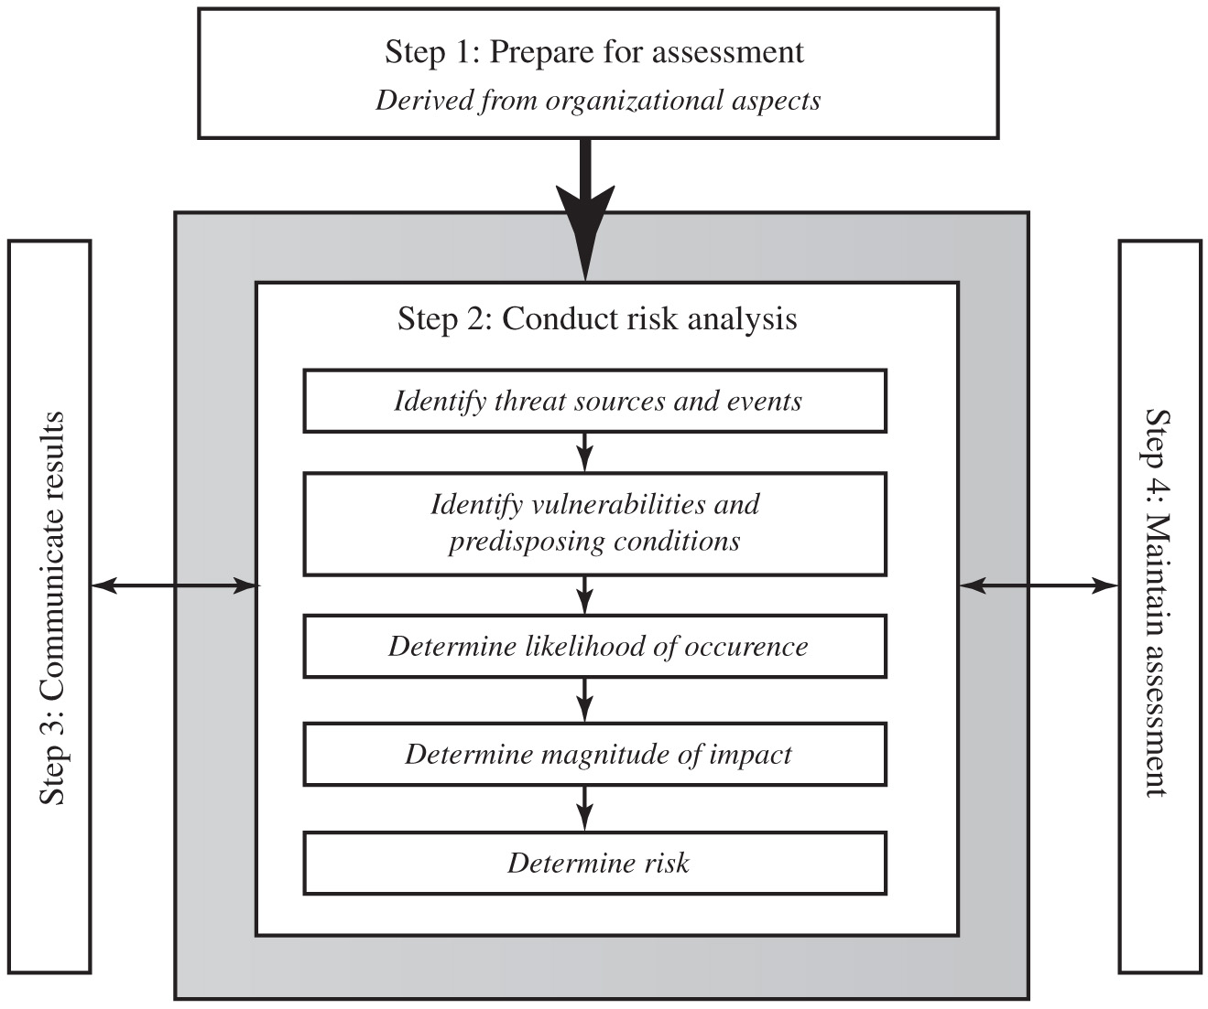
Figure 14.3 Risk Assessment Process
Notes:
A number of national and international standards document the expected formal risk analysis approach. These include ISO 27005, ISO 31000, NIST SP 800-30, and [SASN13]. This approach is often mandated by government organizations and associated businesses. These standards all broadly agree on the process used. Figure 14.3 (reproduced from figure 5 in NIST SP 800-30) illustrates a typical process used.
The steps are as follows. Step 1. Prepare for assessment, derived from organizational aspects. Step 2. Conduct risk analysis. Identify threat sources and events. Identify vulnerabilities and predisposing conditions. Determine likelihood of occurrence. Determine magnitude of impact. Determine risk. Step 3. Communicate results. Step 4. Maintain assessment.

Slide 22
Establishing the Context
The initial step is known as establishing the context or system characterization. – Application areas: finance, banking, or manufacturing?
Initial step
Determine the basic parameters of the risk assessment
Identify the assets to be examined
Explores political and social environment in which the organization operates
Legal and regulatory constraints
Provide baseline for organization’s risk exposure
Risk appetite
The level of risk the organization views as acceptable
Notes:
The initial step is known as establishing the context or system characterization . Its purpose is to determine the basic parameters within which the risk assessment will be conducted, and then to identify the assets to be examined.
The process starts with the organizational security objectives and considers the broad risk exposure of the organization. This recognizes that not all organizations are equally at risk, but that some, because of their function, may be specifically targeted. It explores the relationship between a specific organization and the wider political and social environment in which it operates.
Industries such as agriculture and education are considered to be at lesser risk compared to government or banking and finance. Note that this classification predates September 11, and it is likely that there has been change since it was developed. In particular it is likely that utilities, for example, are probably at higher risk than the classification suggests. NIST has indicated that the following industries are vulnerable to risks in Supervisory Control and Data
Acquisition (SCADA) and process control systems: electric, water and wastewater, oil and natural gas, chemical, pharmaceutical, pulp and paper, food and beverage, discrete manufacturing (automotive, aerospace, and durable goods), air and rail transportation, and mining and metallurgy.
At this point in determining an organization’s broad risk exposure, any relevant legal and regulatory constraints must also be identified. These features provide a baseline for the organization’s risk exposure and an initial indication of the broad scale of resources it needs to expend to manage this risk in order to successfully conduct business.
Next, senior management must define the organization’s risk appetite , the level of risk the organization views as acceptable. Again this will depend very much on the type of organization, and its management’s attitude to how it conducts business. For example, banking and finance organizations tend to be fairly conservative and risk averse. This means they want a low residual risk and are willing to spend the resources necessary to achieve this. In contrast, a leading-edge manufacturer with a brand new product may have a much greater risk tolerance. The manufacturer is willing to take a chance to obtain a competitive advantage, and with limited resources wishes to expend less on risk controls. This decision is not just IT specific. Rather it reflects the organization’s broader management approach to how it conducts business.

Slide 23
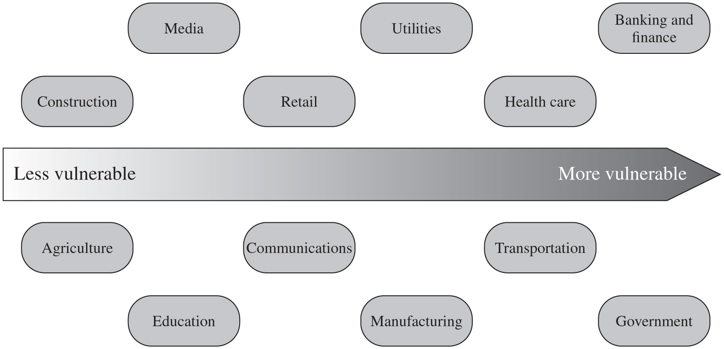
Figure 14.4 Generic Organizational Risk Context
Notes:
Figure 14.4 (adapted from an IDC 2000 report) suggests a possible spectrum of organizational risk. The organizational risk ranges from less vulnerable to more vulnerable. The contexts are as follows. Construction, Media, Retail, Utilities, Health care, Banking and finance, Agriculture, Education, Communication, Manufacturing, Transportation, and Government.

Slide 24
Asset Identification
identify assets
“anything which needs to be protected”
of value to organization to meet its objectives
tangible or intangible
in practice try to identify significant assets
Assets:
Hardware
Software
Information (Intellectual Property)
draw on expertise of people in relevant areas of organization to identify key assets
identify and interview such personnel
see checklists in various standards
Notes:
The last component of this first step in the risk assessment is to identify the assets to examine. This directly addresses the first of the three fundamental questions “What assets do we need to protect?”. An asset is “anything which needs to be protected” because it has value to the organization and contributes to the successful attainment of the organization’s objectives, and may be either tangible or intangible. It includes computer and communications hardware infrastructure, software including applications, information/data held on these systems, the documentation on these systems, and the people who manage and maintain these systems. Within the boundaries identified for the risk assessment, these assets need to be identified, and their value to the organization assessed. It is important to emphasize again, that whilst the ideal is to consider every conceivable asset, in practice this is not possible. Rather the goal here is to identify all assets that contribute significantly to attaining the organization’s objectives, and whose compromise or loss would seriously impact on the organizations operation.
Whilst the risk assessment process is most likely being managed by security experts, they will not necessarily have a high degree of familiarity with the organization’s operation and structures. Thus they need to draw on the expertise of the people in the relevant areas of the organization to identify key assets and their value to the organization. A key element of this process step is identifying and interviewing such personnel. Many of the standards listed previously include checklists of types of assets and suggestions for mechanisms for gathering the necessary information. These should be consulted and used. The outcome of this step should be a list of assets, with brief descriptions of their use by, and value to, the organization.

Slide 25
Terminology
Notes:
The next step in the process is to identify the threats or risks the assets are exposed to. It is worth commenting on the terminology used here. The terms “threat” and “risk”, whilst having distinct meanings, are often used interchangeably in this context. There is considerable variation in the definitions of these terms, as seen in the range of definitions provided in the cited standards. [ISO13335] includes the definitions shown here. The relationship between these and other security concepts is illustrated in Figure 1.2 of the text. It shows the central term risk results from a threat exploiting vulnerabilities in assets which causes loss of value to the organization.

Slide 26
Threat Identification
to identify threats or risks to assets as
who or what could cause it harm?
how could this occur?
threats are anything that hinders or prevents an asset providing appropriate levels of the key security services:
confidentiality, integrity, availability, accountability, authenticity and reliability
assets may have multiple threats
Notes:
Identifying the threats or risks the assets are exposed to directly addresses the second of our three fundamental questions: “How are those assets threatened?”. The goal of this stage is to identify potentially significant risks to the assets listed. This requires answering the following questions for each asset:
1. Who or what could cause it harm? and
2. How could this occur?
Answering the first of these questions involves identifying potential threats to assets. In the broadest sense a threat is anything that might hinder or prevent an asset providing appropriate levels of the key security services: confidentiality, integrity, availability, accountability, authenticity and reliability. Note that one asset may have multiple threats, and a single threat may target multiple assets.

Slide 27
Threat Sources
threats may be
natural “acts of god”
man-made
either accidental or deliberate
should consider human attackers
motivation
capability
resources
probability of attack
deterrence
any previous history of attack on org
Notes:
A threat may be either natural or man-made, and may be accidental or deliberate. This is known as the threat-source. The classic “natural” threat sources are those often referred to as “acts of god”, and include damage caused by fire, flood, storm, earthquake and other such natural events. It also includes “environmental threats” such as long-term loss of power or natural gas. Or it may be the result of chemical contamination or leakage. Alternatively a threat source may be a human agent acting either directly or indirectly. Examples of the former include an insider retrieving and selling information for personal gain, or a hacker targeting the organizations server over the Internet. An example of the latter includes someone writing and releasing a network worm that infects the organizations systems. These examples all involved a deliberate exploit of a threat. However, a threat may also be a result of an accident, such as an employee incorrectly entering information on a system, which results in it malfunctioning. The possible motivation of deliberate attackers in relation to the organization should be considered as potentially influencing this variation. In addition, any previous experience of attacks seen by the organization needs to be considered, as that is concrete evidence of risks that are known to occur. When evaluating possible human threat sources, it is worth considering their reason and capabilities for attacking this organization, including their:
• motivation: why would they target this organization, how motivated are they?
• capability: what is their level of skill in exploiting the threat?
• resources: how much time, money, and other resources could they deploy?
• probability of attack: how likely and how often would your assets be targeted?
• deterrence: what are the consequences to the attacker of being identified?

Slide 28
Threat Identification
depends on risk assessors experience
uses variety of sources
natural threat chance from insurance stats
lists of potential threats in standards, IT security surveys, info from governments
tailored to organization’s environment
and any vulnerabilities in its IT systems
Notes:
Identifying possible threats and threat sources requires the use of a variety of sources, along with the experience of the risk assessor. The chance of natural threats occurring in any particular area is usually well known from insurance statistics. Lists of other potential threats may be found in the standards, in the results of IT security surveys, and in information from government security agencies. The annual computer crime surveys, such as those conducted by the CSI/FBI in the US and AusCERT in Australia, provide useful general guidance on the broad IT threat environment and the most common problem areas. However, this general guidance needs to be tailored to the organization and the risk environment it operates in. This involves consideration of vulnerabilities in the organization’s IT systems, which may indicate that some risks are either more or less likely than the general case.

Slide 29
Vulnerability Identification
identify exploitable flaws or weaknesses in organization’s IT systems or processes
hence determine applicability and significance of threat to organization
need combination of threat and vulnerability to create a risk to an asset
again can use lists of potential vulnerabilities in standards etc
Notes:
Answering the second of these questions “How could this occur?” involves identifying flaws or weaknesses in the organization’s IT systems or processes which could be exploited by a threat. This will help determine the applicability of the threat to the organization, and its significance. Note that mere existence of some vulnerability does not mean harm will be caused to an asset. There must also be a threat source for some threat that can exploit the vulnerability for harm to possibly occur. It is the combination of a threat and a vulnerability that creates a risk to an asset. Again, many of the standards listed previously include checklists of threats and vulnerabilities, and suggestions for tools and techniques to list them, and to determine their relevance to the organization. The outcome of this step should be a list of threats and vulnerabilities, with brief descriptions of how and why they might occur.

Slide 30
Security Analysis
Attacks: Infinite set
Vulnerabilities: Infinite set
Assets: Finite set
Threats: Finite set

Slide 31
Analyze Risks
Likelihood: likelihood of occurrence of each identified threat to asset given existing controls
Attacker skills
Motivation
Difficulty
Impact: specify consequence should threat occur
Effects on Confidentiality, Integrity, or Availability
Cost of Asset
hence derive overall risk rating for each threat
risk = probability threat occurs * cost to organization (Quantitative)
in practice very hard to determine exactly
use qualitative not quantitative, ratings for each
Notes:
The next step is to to identify and categorize the risks to assets that threaten the regular operations of the organization, and to provide information to management to help them evaluate these risks and determine how best to treat them. Risk analysis involves firstly specifying the likelihood of occurrence of each identified threat to an asset, in the context of any existing controls (management, operational and technical processes and procedures that act to reduce the exposure of the organization to some risks, by reducing the ability of a threat source to exploit some vulnerabilities). Next the consequence to the organization is determined, should that threat eventuate. Lastly this information is combined to derive an overall risk rating for each threat. The ideal would be to specify the likelihood as a probability value, and the consequence as a monetary cost to the organization should it occur. The resulting risk is then simply given as:
Risk = Probability threat occurs x Cost to organization
This can be directly equated to the value the threatened asset has for the organization, and hence specify what level of expenditure is reasonable to reduce the probability of its occurrence to an acceptable level. Unfortunately it is often extremely hard to determine accurate probabilities, realistic cost consequences, or both. This is particularly true of intangible assets, like the loss of confidentiality of a trade secret for example. Hence most risk analyses use qualitative, rather than quantitative, ratings for both these items. The goal is then to order the resulting risks to help determine which need to be most urgently treated, rather than give them an absolute value.

Slide 32
Determine Likelihood
Notes:
Having identified existing controls, the likelihood that each identified threat could occur and cause harm to some asset needs to be specified. The risk analyst takes the descriptive asset and threat/vulnerability details from the preceding steps in this process, and in the light of the organizations overall risk environment and existing controls, decides the appropriate rating. This estimation relates to the likelihood of the specified threat exploiting one or more vulnerabilities to an asset or group of assets, which results in harm being caused to the organization. The likelihood is typically described qualitatively, using values and descriptions such as those shown here from Table 16.2 in the text. Whilst the various risk assessment standards all suggest tables similar to these, there is considerable variation in their detail.
The specified likelihood needs to be realistic. In particular, a rating of Likely or higher suggests that this threat has occurred sometime previously. This means past history provides supporting evidence for its specification. If this is not the case, then specifying such a value would need to be justified on the basis of a significantly changed threat environment, a change in the IT systems which has weakened it’s security, or some other rationale for its anticipated likely occurrence. In contrast, the Unlikely and Rare ratings can be very hard to quantify. They are an indication that the threat is of concern, but knowing whether it could potentially occur is difficult to specify. Typically such threats would only be considered if the consequences to the organization of their occurrence are so severe that they have to be considered, even if extremely improbable.

Slide 33
Determine Consequence
Notes:
The analyst must then specify the consequence of a specific threat eventuating, which is distinct from, and not related to, the likelihood of the threat occurring. Rather, consequence specification indicates the impact on the organization should the particular threat in question actually eventuate. Even if a threat is regarded as rare or unlikely, if the organization would suffer severe consequence should it occur, then it clearly poses a risk to the organization. Hence, appropriate responses must be considered. A qualitative descriptive value, such as those shown here from Table 16.3 in the text, is typically used to describe the consequence. As with the likelihood ratings, there is likely to be some uncertainty as to the best rating to use.
This determination should be based upon the judgment of the asset’s owners, and the organization’s management, rather than the opinion of the risk analyst. This is in contrast with the likelihood determination. The specified consequence needs to be realistic. It must relate to the impact on the organization as a whole should this specific threat eventuate. It is not just the impact on the affected system. It is possible that a particular system (a server in one location for example) might be completely destroyed in a fire. However, the impact on the organization could vary from it being a minor inconvenience (the server was in a branch office, and all data was replicated elsewhere), to a major disaster (the server had the sole copy of all customer and financial records for a small business). As with the likelihood ratings, the consequence ratings must be determined knowing the organization’s current practices and arrangements. In particular the organization’s existing backup, disaster recovery, and contingency planning, or lack thereof, will influence the choice of rating.

Slide 34
Determine Resultant Risk
Consequences
Likelihood
Doomsday
Catastrophic
Major
Moderate
Minor
Insignificant
Almost
E
E
E
E
H
H
Certain
Likely
E
E
E
H
H
M
Possible
E
E
E
H
M
L
Unlikely
E
E
H
M
L
L
Rare
E
H
H
M
L
L
Risk Level
Description
Extreme (E)
Will require detailed r
esearch and management planning at an
executive/director level. Ongoing planning and monitoring will be required
with regular reviews. Substantial adjustment of controls to manage the
risk are expected, with costs possibly exceeding original forecasts.
H
igh (H)
Requires management attention, but management and planning can be left
to senior project or team leaders. Ongoing planning and monitoring with
regular reviews are likely, though adjustment of controls are likely to be
met from within existing resources
Medium (M)
Can be managed by existing specific monitoring and response procedures.
Management by employees is suitable with appropriate monitoring and
reviews.
Low (L)
Can be managed through routine procedures.
Hardware Integrity:Low: Fewer possible attacks, lower consequences, relatively easy to safeguards
Software integrity: High: More possible attacks, higher consequences, relatively harder to safeguards
Qualitative: Low, Medium, High.
Quantitative: 1- 5, 1-10, 1-100 (Nuclear Power Plant)
Notes:
Once the likelihood and consequence of each specific threat have been identified, a final level of risk can be assigned. This is typically determined using a table that maps these values to a risk level, such as those shown in Table 16.4 from the text. This table details the risk level assigned to each combination. Such a table provides the qualitative equivalent of performing the ideal risk calculation using quantitative values. It also indicates the interpretation of these assigned levels.

Slide 35
Document in Risk Register and Evaluate Risks
Notes:
The results of the risk analysis process should be documented in a risk register. This should include a summary table such that shown in Table 16.5 from the text. The risks are usually sorted in decreasing order of level. This would be supported by details of how the various items were determined, including the rationale, justification, and supporting evidence used. The aim of this documentation is to provide senior management with the information they need to make appropriate decisions as how to best manage the identified risks. It also provides evidence that a formal risk assessment process has been followed if needed, and a record of decisions taken with their reasons.
Once the details of potentially significant risks are determined, management needs to decide whether it needs to take action in response. This would take into account the risk profile of the organization, and its willingness to accept a certain level of risk, as determined in the initial “Establishing the Context” phase of this process. Those items with risk levels below the acceptable level would usually be accepted with no further action required. Those items with risks above this will need to be considered for treatment. Typically the risks with the higher ratings are those that need most urgently action. However, it is likely that some risks will be easier, faster, and cheaper to action than others. In the example shown, both risks were rated High. Further investigation reveals that a relatively simple and cheap treatment exists for the first risk, by tightening the router configuration to further restrict possible accesses. Treating the second risk requires the development of a full disaster recovery plan, a much slower and more costly process. Hence management would take the simple action first, to improve the organization’s overall risk profile as quickly as possible.

Slide 36
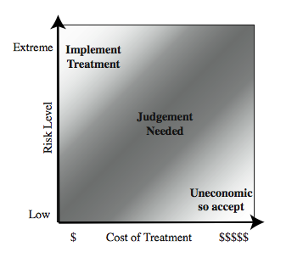
Risk Treatment
Judgements: Justfiable
Notes:
Management may decide that for business reasons, given an overall view of the organization, some risks with lower levels should be treated ahead of other risks. This is both a reflection of limitations in the risk analysis process in the range of ratings available and their interpretation, and management’s perspective of the organization as a whole. Figure 16.5 from the text shows a range of possibilities for costs verses levels of risk. If the cost of treatment is high, but the risk is low, then it is usually uneconomic to proceed with such treatment. Alternatively, where the risk is high, and the cost comparatively low, then clearly treatment should occur. The most difficult area occurs between these extremes. This is where management must make a business decision about the most effective use of their available resources. This decision usually requires a more detailed investigation of the treatment options.

Slide 37
Risk Treatment Alternatives
risk acceptance: accept risk (perhaps because of excessive cost of risk treatment)
risk avoidance: do not proceed with the activity that causes the risk (loss of convenience)
risk transfer: buy insurance; outsource
reduce consequence: modify the uses of an asset to reduce risk impact (e.g., offsite backup)
reduce likelihood: implement suitable controls
Notes:
There are five broad alternatives available to management for treating identified risks:
risk acceptance: of a risk level greater than normal for business reasons, typically due to excessive cost or time needed to treat the risk. Management must then accept responsibility for the consequences to the organization should the risk eventuate.
risk avoidance: not proceeding with the activity or system which creates this risk, resulting in loss of convenience or ability to perform some function that is useful to the organization, but traded off against the reduced risk profile.
risk transferal: sharing responsibility for the risk with a third-party. This is typically achieved by taking out insurance against the risk occurring, by entering into a contract with another organization, or by using partnership or joint venture structures to share the risks and costs should it eventuate.
reduce the consequence: by modifying the structure or use of the assets at risk to reduce the impact on the organization should the risk occur. This could be achieved by implementing controls to enable the organization to quickly recover should the risk occur. Examples include implementing an offsite backup process, developing a disaster recovery plan, or arranging for data and processing to be replicated
reduce the likelihood: by implementing suitable controls to lower the chance of the vulnerability being exploited. These could include technical or administrative controls such as deploying firewalls and access tokens, or procedures such as password complexity and change policies. Such controls aim to improve the security of the asset, making it harder for an attack to succeed by reducing the vulnerability of the asset.
If either of the last two options is chosen, then possible treatment controls need to be selected, and their cost effectiveness evaluated. We discuss this in the text chapter 17.

Slide 38
Risk Management – Iterative Process
Context → Assessment -- >Treatment → Acceptance → Context…
Establish the context
Risk Assessment
Identify
Measure
Prioritise
Treatment : Treat the risk
Reduce
Avoid
Share
Accept (Not enough resources)
Risk Communication:
Risks
Security Controls
Monitor and Review – Iterative Process
Notes:
The key risk management component of the IT security process is critical, since without it there is a significant chance that resources will not be deployed where most effective. The result will be that some risks are not addressed, leaving the organization vulnerable, whilst other safeguards may be deployed without sufficient justification, wasting time and money. Ideally every single organizational asset is examined, and every conceivable risk to it evaluated. If a risk is judged to be too great, then appropriate remedial controls are deployed to reduce the risk to an acceptable level. In practice this is clearly impossible.
Given the very wide range of organizations there clearly needs to be a range of alternatives available in performing this process. There are a range of formal standards which detail suitable IT security risk assessment processes, including [ISO13335] and [NIST02]. In particular, [ISO13335] recognizes four approaches to identifying and mitigating risks to an organization's IT infrastructure: baseline approach, informal approach, detailed risk analysis, combined approach.
The choice among these will be determined by the resources available to the organization, and from an initial high-level risk analysis that considers how valuable the IT systems are, and how critical to the organization’s business objectives. Legal and regulatory constraints may also require specific approaches. This information should be determined when developing the organization’s IT security objectives, strategies and policies.

Slide 39
Case Study: Silver Star Mines
fictional operation of global mining company
large IT infrastructure
both common and specific software
some directly relates to health & safety
formerly isolated systems now networked
decided on combined approach
mining industry less risky end of spectrum
management accepts moderate or low risk
Notes:
This case study involving the operations of a fictional company “Silver Star Mines”, the local operations of a large global mining company. It has a large IT infrastructure used by numerous business areas. Its network includes a variety of servers, executing a range of application software typical of organizations of its size. It also uses applications that are far less common, some of which directly relates to the health and safety of those working in the mine. Many of these systems used to be isolated, with no network connections between them. In recent years they have been connected together, and connected to the company’s intranet to provide better management capabilities. However, this means they are now potentially accessible from the Internet, which has greatly increased the risks to these systems.
A security analyst was contracted to provide an initial review of the company’s risk profile, and to recommend further action for improvement. Following initial discussion with company management, a decision was made to adopt a “combined approach” to security management. The analyst was then asked to conduct a preliminary formal assessment of their key IT systems to identify those most at risk, which management could then consider for treatment.
The first step was to determine the context for the risk assessment. Being in the mining industry sector places the company at the less risky end of the spectrum, and consequently less likely to be specifically targeted. Silver Star Mines is part of a large organization, and hence is subject to legal requirements for occupational health and safety, and is answerable to its shareholders. Thus management decided that they wished to accept only moderate or lower risks in general.

Slide 40

Assets
Reliability and integrity of
S C A D A nodes and net
Availability, integrity and confidentiality of mail services
Integrity of stored file and database information
Availability, integrity of maintenance/production system
Availability, integrity of financial system
Availability, integrity of procurement system
Notes:
Next, the key assets had to be identified. The analyst conducted interviews with key IT and engineering managers in the company. A number of the engineering managers emphasized how important the reliability of the SCADA network and nodes were to the company. They control and monitor the core mining operations of the company and enable it to operate safely and efficiently and, most crucially, to generate revenue. Some of these systems also maintain the records required by law, which are regularly inspected by the government agencies responsible for the mining industry. Any failure to create, preserve, and produce on demand these records would expose the company to fines and other legal sanctions. Hence, these systems were listed as the first key asset.
A number of the IT managers indicated that a large amount of critical data was stored on various file servers either in individual files or in databases. They identified the importance of the integrity of these data to the company. Some of these data were generated automatically by applications. Other data were created by employees using common office applications. Some of this needed be available for audits by government agencies. There were also data on production and operational results, contracts and tendering, personnel, application backups, operational and capital expenditure, mine survey and planning, and exploratory drilling. Collectively, the integrity of stored data was identified as the second key asset.
These managers also indicated that three key systems—the Financial, Procurement, and Maintenance/Production servers—were critical to the effective operation of core business areas. Any compromise in the availability or integrity of these systems would impact the company’s ability to operate effectively. Hence each of these were identified as a key asset.

Slide 41
Assets
reliability and integrity of SCADA (supervisory control and data acquisition) nodes and net
integrity of stored file and database information
availability, integrity of financial system
availability, integrity of procurement system
availability, integrity of maintenance/production system
availability, integrity and confidentiality of mail services
Notes:
Next, the key assets had to be identified. The analyst conducted interviews with key IT and engineering managers in the company. A number of the engineering managers emphasized how important the reliability of the SCADA (Supervisory Control and Data Acquisition) network and nodes were to the company. They control and monitor the core mining operations of the company and enable it to operate safely, efficiently, and most crucially to generate revenue. Some of these systems also maintain the records required by law, and which are regularly inspected by the government agencies responsible for the mining industry. Any failure to create, preserve and produce on demand these records would expose the company to fines and other legal sanctions. Hence, these systems were listed as the first key asset. A number of the IT managers indicated that a large amount of critical data was stored on various file servers either in individual files, or in databases. They identified the importance of the integrity of this data to the company. Some of this needed be available for audits by government agencies. There were also data on production and operational results, contracts and tendering, personnel, application backups, operational and capital expenditure, mine survey and planning, and exploratory drilling. Collectively, the integrity of stored data was the second key asset. These managers also indicated that three key systems: the Financial, Procurement, and Maintenance/Production servers, were critical to the effective operation of core business areas. Any compromise in the availability or integrity of these systems would impact on the company’s ability to operate effectively. Lastly, the analyst identified e-mail as a key asset, as a result of interviews with all business areas of the company. E-mail is given greater importance than usual due to the remote location of the company. Hence the collective availability, integrity and confidentiality of mail services was listed as a key asset.

Slide 42
Threats & Vulnerabilities
unauthorized modification of control system
corruption, theft, loss of info
attacks/errors affecting procurement system
attacks/errors affecting financial system
attacks/errors affecting mail system
attacks/errors maintenance/production affecting system
Notes:
Having determined the list of key assets, the analyst needed to identify significant threats to these assets, and to specify the likelihood and consequence values. The major concern with the SCADA asset is unauthorized compromise of nodes by an external source. These systems were originally designed for use on physically isolated and trusted networks, and hence were not hardened against external attack to the degree that modern systems can be. Recognizing that the SCADA nodes are very likely insecure, these connections are isolated from the company intranet by additional firewall and proxy server systems. The second asset concerned the integrity of stored information. These assets could be compromised by both internal and external sources. All indications are that such database security breaches are increasing, and that access to such data is a primary goal of intruders. These systems are located on the company intranet, and hence are shielded by the company’s outer firewall from much external access. However, should that firewall be compromised, or an attacker gain indirect access using infected internal systems, compromise of the data was possible. The availability or integrity of the key Financial, Procurement, and Maintenance/Production systems could be compromised by any form of attack on the operating system or applications they use. Although their location on the company intranet does provide some protection, due to the nature of the company structure a number of these systems have not been patched or maintained for some time. This means at least some of the systems would be vulnerable to a range of network attacks if accessible. The last asset is the availability, integrity and confidentiality of mail services. Without an effective e-mail system the company will operate with less efficiency.

Slide 43
Risk Register
Notes:
Given that externally sourced attacks are increasing, and known cases of attacks on SCADA networks exist, the analyst concluded that whilst an attack was very unlikely, it could still possibly occur. Thus a likelihood rating of Rare was chosen. The consequence of successful attack could have serious consequences as it could affect the safety of personnel in the mine, and the financial impact could be. A consequence rating of Major was selected. This results in a risk level of High. For integrity of stored information, a likelihood rating of Possible was chosen. Discussions with IT managers revealed that some of this information is confidential and may cause financial harm if disclosed to others, as well as the possibility of serious legal consequences if personal information was disclosed, or if the results of statutory tests and process information were lost. Hence a consequence rating of Major was selected. This results in a risk level of Extreme. For availability or integrity of the key Financial, Procurement, and Maintenance/Production systems a likelihood of Possible was specified. Discussions with management indicated that the degree of harm would be proportional to extent and duration of the attack. An attack would have a detrimental impact on the efficiency of operations. Consequence ratings of Moderate and Minor respectively were selected, resulting in risk levels of High or Medium. For availability, integrity and confidentiality of mail services, a likelihood rating of Almost Certain was selected in recognition of the wide range of possible attacks, and the high chance that one will occur sooner rather than later. Discussions with management indicated that whilst other possible modes of communication exist, they do not allow for transmission of electronic documents. Since compromise would not have a large impact, a consequence of Minor was selected. This results in a risk level of High. The information was summarized and presented to management, with the final result of this risk assessment process is shown in this Table 16.6.

Slide 44
Summary
I T security management
Organizational context and security policy
Security risk assessment
Baseline approach
Informal approach
Detailed risk analysis
Combined approach
Detailed security risk analysis
Context and system characterization
Identification of threats/risks/vulnerabilities
Analyze risks
Evaluate risks
Risk treatment
Case study: Silver Star Mines
Notes:
Chapter 14 summary.

Slide 45
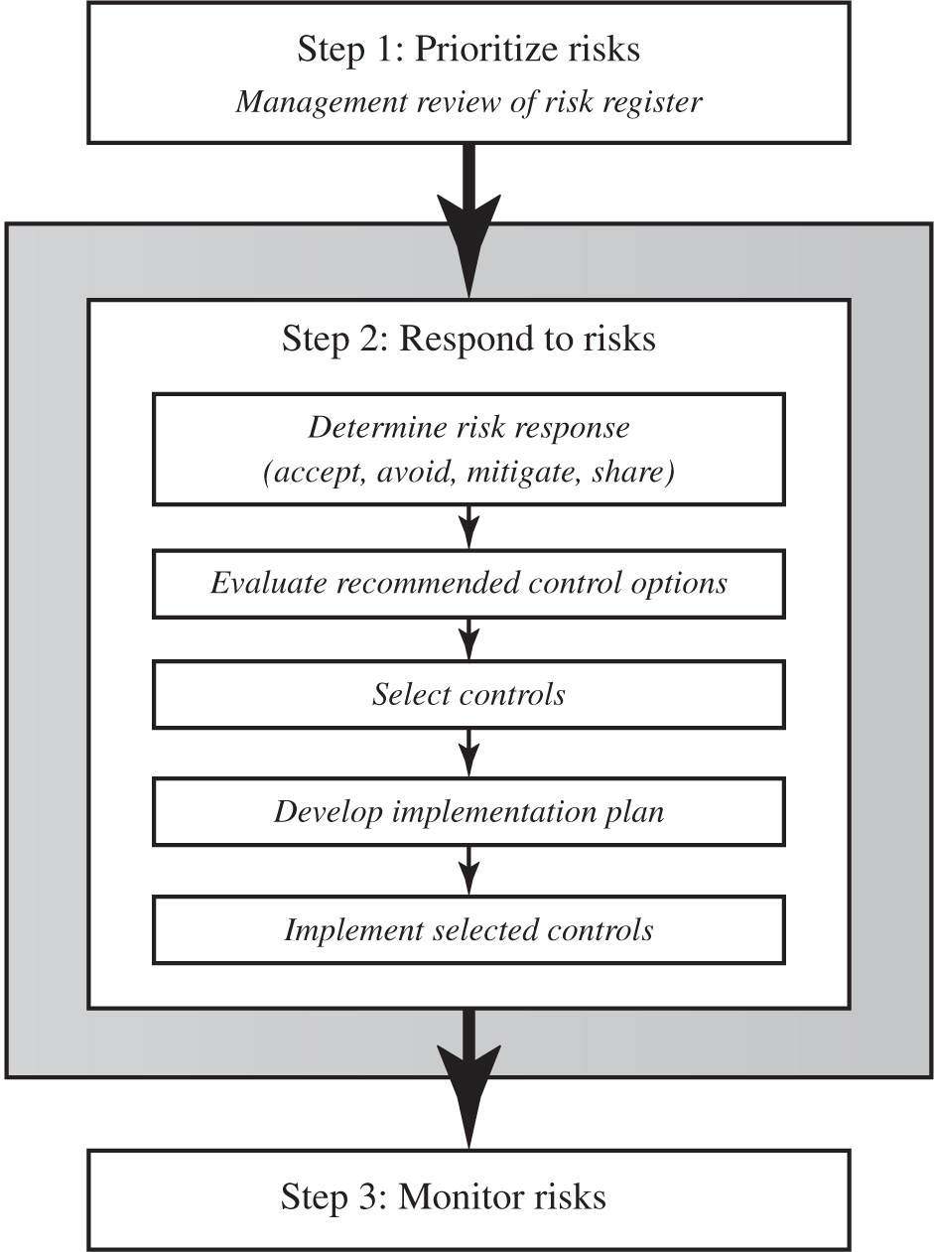
Figure 15.1 I T Security Management Controls and Implementation
Notes:
We introduced the IT security management process in Chapter 14, illustrated by Figure 14.1. Chapter 14 focused on the earlier stages of this process. In this chapter, we focus on the latter stages, which include selecting controls, developing an implementation plan, and the follow-up monitoring of the plan’s implementation. We broadly follow the guidance provided in NIST SP 800-39 (Managing Information Security Risk: Organization, Mission, and Information System View , March 2011), which was developed by NIST in 2011 as the flagship document for providing guidance for an integrated, organization-wide program for managing information security risk, in response to FISMA. A broad summary of these steps is given in Figure 15.1. We will discuss each of these in turn.
The illustration involves the steps as follows.
Step 1. Prioritize risks, Management review of risk register.
Step 2. Respond to risks. Step 2 involves the following.
• Determine risk response, accept, avoid, mitigate, share
• Evaluate recommended control options
• Select controls
• Develop implementation plan
• Implement selected controls
Step 3. Monitor risks. Arrows extend from one step to the other.

Slide 46
Security Control
Control is defined as:
“An action, device, procedure, or other measure that reduces risk by eliminating or preventing a security violation, by minimizing the harm it can cause, or by discovering and reporting it to enable corrective action.”
Configured
Integrated
Monitored
Updated
Replaced
Notes:
A risk assessment on an organization’s IT systems identifies areas needing treatment. The next step, as shown in Figure 14.1 on risk analysis options, is to select suitable controls to use in this treatment. An IT security control, safeguard, or countermeasure (the terms are used interchangeably) helps to reduce risks. We use the following definition:
“An action, device, procedure, or other measure that reduces risk by eliminating or preventing a security violation, by minimizing the harm it can cause, or by discovering and reporting it to enable corrective action.”

Slide 47
Security Control
Reduce Risk
Achieve Security Goals
Security Control Categories
Access Control
Cryptography
Communication Security
Asset and Media Management
Incident Management
Secure Development Lifecycle
Human Resources security
Physical Security
System Acquisition
Supplier Relations
Notes:
A risk assessment on an organization’s IT systems identifies areas needing treatment. The next step, as shown in Figure 14.1 on risk analysis options, is to select suitable controls to use in this treatment. An IT security control, safeguard, or countermeasure (the terms are used interchangeably) helps to reduce risks. We use the following definition:
“An action, device, procedure, or other measure that reduces risk by eliminating or preventing a security violation, by minimizing the harm it can cause, or by discovering and reporting it to enable corrective action.”

Slide 48
Security Management
Staff Management
Vetting
Security and Awareness Training
Good Security Practices
Use Security Technology Effectively
Notes:
Employees are typically the biggest security risk in an organization.

Slide 49
Security Development Lifecycle
Tasks
Security Development environment
Source Code Review
Security Testing
Outsourced components review
Security and privacy assessments
Notes:
A risk assessment on an organization’s IT systems identifies areas needing treatment. The next step, as shown in Figure 14.1 on risk analysis options, is to select suitable controls to use in this treatment. An IT security control, safeguard, or countermeasure (the terms are used interchangeably) helps to reduce risks. We use the following definition:
“An action, device, procedure, or other measure that reduces risk by eliminating or preventing a security violation, by minimizing the harm it can cause, or by discovering and reporting it to enable corrective action.”

Slide 50
Control Classifications
Management controls
Focus on security policies, planning, guidelines, and standards that influence the selection of operational and technical controls to reduce the risk of loss and to protect the organization’s mission
These controls refer to issues that management needs to address
Operational controls
Address the correct implementation and use of security policies and standards, ensuring consistency in security operations and correcting identified operational deficiencies
These controls relate to mechanisms and procedures that are primarily implemented by people rather than systems
They are used to improve the security of a system or group of systems
Technical controls
Involve the correct use of hardware and software security capabilities in systems
These range from simple to complex measures that work together to secure critical and sensitive data, information, and I T systems functions
Notes:
Some controls address multiple risks at the same time, and selecting such controls can be very cost effective. Controls can be classified as belonging to one of the following classes (although some controls include features from several of these):
• Management controls: Focus on security policies, planning, guidelines, and standards that influence the selection of operational and technical controls to reduce the risk of loss and to protect the organization’s mission. These controls refer to issues that management needs to address. We discuss a number of these in Chapters 14 and 15.
• Operational controls: Address the correct implementation and use of security policies and standards, ensuring consistency in security operations and correcting identified operational deficiencies. These controls relate to mechanisms and procedures that are primarily implemented by people rather than systems. They are used to improve the security of a system or group of systems. We will discuss some of these in Chapters 16 and 17.
• Technical controls: Involve the correct use of hardware and software security capabilities in systems. These range from simple to complex measures that work together to secure critical and sensitive data, information, and IT systems functions.

Slide 51
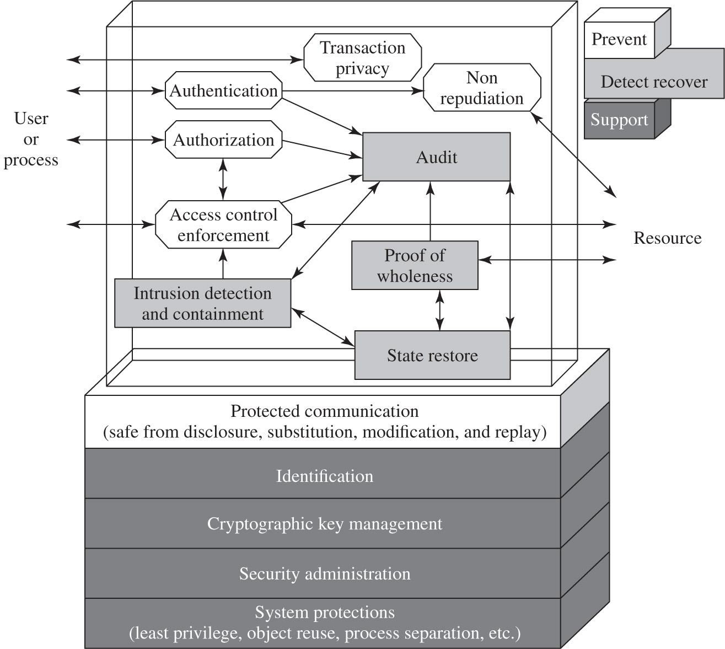
Figure 15.2 Technical Security Controls
Notes:
Figure 15.2 illustrates some typical technical control measures. Parts One and Two in this text discussed aspects of such measures.
The illustration has two frames. In the first frame, double headed arrows extend between the user or process and the blocks, Authentication, Authorization, Access control enforcement, and Transaction privacy. The authentication block communicates to the resource through the non repudiation block. Arrow extends from Authentication, Authorization, and Access control enforcement to the Audit block. Double headed arrows extend between Authorization and Access control enforcement. Double headed arrows extend between the three blocks, Audit, State restore, and Intrusion detection and containment. An arrow extends from the intrusion detection and containment to the access control enforcement. Double headed arrows extend between Proof of wholeness and state restore. An arrow extends from proof of wholeness to audit. The blocks classified under Prevent are as follows. Authentication, Authorization, Transaction Privacy, Non repudiation, and Access control enforcement. The blocks classified under detect recover are as follows. Audit, Intrusion detection and containment, Proof of wholeness, State restore. The second frame has stacked layers as follows.
• Protected communication, safe from disclosure, substitution, modification, and replay.
• Identification
• Cryptographic key management
• Security administration
• System protections, least privilege, object reuse, process separation, et cetera.
In the second frame, the layers except the protected communication layer come under support, while the protected communication comes under prevent.

Slide 52
Control Classes
Each of the control classes may include the following:
Supportive controls
Pervasive, generic, underlying technical I T security capabilities that are interrelated with, and used by, many other controls
Preventative controls
Focus on preventing security breaches from occurring, by inhibiting attempts to violate security policies or exploit a vulnerability
Detection and recovery controls
Focus on the response to a security breach, by warning of violations or attempted violations of security policies or the identified exploit of a vulnerability and by providing means to restore the resulting lost computing resources
Notes:
In turn, each of these control classes may include the following:
• Supportive controls: Pervasive, generic, underlying technical IT security capabilities that are interrelated with, and used by, many other controls.
• Preventative controls: Focus on preventing security breaches from occurring, by inhibiting attempts to violate security policies or exploit a vulnerability.
• Detection and recovery controls: Focus on the response to a security breach, by warning of violations or attempted violations of security policies or the identified exploit of a vulnerability and by providing means to restore the resulting lost computing resources.
The technical control measures shown in Figure 15.2 include examples of each of these types of controls.

Slide 53
Table 15.1 N I S T S P 800-53 Security Controls
Class | Control Family
Management | Planning
Management | Program Management
Management | Risk Assessment
Management | Security Assessment and Authorization
Management | System and Services Acquisition
Operational | Awareness and Training
Operational | Configuration Management
Operational | Contingency Planning
Operational | Incident Response
Operational | Maintenance
Operational | Media Protection
Operational | Personnel Security
Operational | Physical and Environmental Protection
Operational | System and Information Integrity
Technical | Access Control
Technical | Audit and Accountability
Technical | Identification and Authentication
Technical | System and Communications Protection
Notes:
Lists of controls are provided in a number of national and international standards, including ISO 27002 (Code of practice for information security management, 2013), ISO 13335 (Management of information and communications technology security, 2004), FIPS 200 (Minimum Security Requirements for Federal Information and Information Systems, March 2006) and NIST SP 800-53 (Recommended Security Controls for Federal Information Systems, January 2015). There is broad agreement among these and other standards as to the types of controls that should be used and the detailed lists of typical controls. Indeed many of the standards cross-reference each other, indicating their agreement on these lists. ISO 27002 is generally regarded as the master list of controls and is cited by most other standards. Table 15.1 (adapted from Table 1 in NIST SP 800-53) is a typical list of families of controls within each of the classes.

Slide 54
Table 15.2 I S O/I E C 27002 Security Controls (1 of 2)
Control Category | Objective
Security Policies | To provide management direction and support for information security in accordance with business requirements and relevant laws and regulations.
Organization of Information Security | To establish a management framework to initiate and control the implementation and operation of information security within the organization; to ensure the security of teleworking and use of mobile devices.
Human Resource Security | To ensure that employees and contractors understand their responsibilities and are suitable for the roles for which they are considered; to ensure that employees and contractors are aware of and fulfill their information security responsibilities; to protect the organization’s interests as part of the process of changing or terminating employment.
Asset Management | To identify organizational assets and define appropriate protection responsibilities; to ensure that information receives an appropriate level of protection in accordance with its importance to the organization; to prevent unauthorized disclosure, modification, removal or destruction of information stored on media.
Access Control | To limit access to information and information processing facilities; to ensure authorized user access and to prevent unauthorized access to systems and services; to make users accountable for safeguarding their authentication information; to prevent unauthorized access to systems and applications.
Cryptography | To ensure proper and effective use of cryptography to protect the confidentiality, authenticity and/or integrity of information.
Physical and Environmental Security | To prevent unauthorized physical access, damage, and interference to the organization’s information and information processing facilities; to prevent loss, damage, theft or compromise of assets and interruption to the organization’s operations.
Notes:
Compare this with the list in Table 15.2, which details the categories of controls given in ISO 27002, and with Table 1.4 which lists controls from FIPS 200, noting the high degree of overlap. Within each of these control classes, there is a long list of specific controls that may be chosen.

Slide 55
Table 15.2 I S O/I E C 27002 Security Controls (2 of 2)
Table 15.2 [continued]
Control Category | Objective
Operations Security | To ensure correct and secure operations of information processing facilities; to ensure that information and information processing facilities are protected against malware; to protect against loss of data; to record events and generate evidence; to ensure the integrity of operational systems; to prevent exploitation of technical vulnerabilities; to minimize the impact of audit activities on operational systems.
Communications Security | To ensure the protection of information in networks and its supporting information processing facilities; to maintain the security of information transferred within an organization and with an external entity.
System Acquisition, Development, and Maintenance | To ensure that information security is an integral part of information systems across the entire lifecycle, including the requirements for information systems which provide services over public networks; to ensure that information security is designed and implemented within the development lifecycle of information systems; to ensure the protection of data used for testing.
Supplier Relationships | To ensure protection of the organization’s assets that are accessible by suppliers; to maintain an agreed level of information security and service delivery in line with supplier agreements.
Information Security Incident Management | To ensure a consistent and effective approach to the management of information security incidents, including communication on security events and weaknesses.
Information Security Continuity | To embed I T continuity in the organization’s business continuity management systems; to ensure availability of information processing facilities.
Compliance | To avoid breaches of legal, statutory, regulatory, or contractual obligations related to information security and of any security requirements; to ensure that information security is implemented and operated in accordance with the organizational policies and procedures.

Slide 56
Table 15.3 Detailed N I S T S P 800-53 Security Controls (1 of 8)
Access Control
Access Control Policy and Procedures, Account Management, Access Enforcement, Information Flow Enforcement, Separation of Duties, Least Privilege, Unsuccessful Login Attempts, System Use Notification, Previous Logon (Access) Notification, Concurrent Session Control, Session Lock, Session Termination, Permitted Actions without Identification or Authentication, Security Attributes, Remote Access, Wireless Access, Access Control for Mobile Devices, Use of External Information Systems, Information Sharing, Publicly Accessible Content, Data Mining Protection, Access Control Decisions, Reference Monitor
Awareness and Training
Security Awareness and Training Policy and Procedures, Security Awareness, Training, Role-Based Security Training, Security Training Records
Notes:
Table 15.3 (adapted from the tables in Appendix D and G of NIST SP 800-53) itemizes the full list of controls detailed in this standard.
To attain an acceptable level of security, some combination of these controls should be chosen. If the baseline approach is being used, an appropriate baseline set of controls is typically specified in a relevant industry or government standard. For example, Appendix D in NIST SP 800-53 lists selections of baseline controls for use in low-, moderate-, and high-impact IT systems. A selection should be made that is appropriate to the organization’s overall risk profile, resources, and capabilities. These should then be implemented across all the IT systems for the organization, with adjustments in scope to address broad requirements of specific systems.

Slide 57
Table 15.3 Detailed N I S T S P 800-53 Security Controls (2 of 8)
Audit and Accountability
Audit and Accountability Policy and Procedures, Audit Events, Content of Audit Records, Audit Storage Capacity, Response to Audit Processing Failures, Audit Review, Analysis, and Reporting, Audit Reduction and Report Generation, Time Stamps, Protection of Audit Information, Nonrepudiation, Audit Record Retention, Audit Generation, Monitoring for Information Disclosure, Session Audit, Alternate Audit Capability, Cross-Organizational Auditing
Security Assessment and Authorization
Security Assessment and Authorization Policies and Procedures, Security Assessments, System Interconnections, Plan of Action and Milestones, Security Accreditation, Continuous Monitoring, Penetration Testing, Internal System Connections
Configuration Management
Configuration Management Policy and Procedures, Baseline Configuration, Configuration Change Control, Security Impact Analysis, Access Restrictions for Change, Configuration Settings, Least Functionality, Information System Component Inventory, Configuration Management Plan, Software Usage Restrictions, User-Installed Software

Slide 58
Table 15.3 Detailed N I S T S P 800-53 Security Controls (3 of 8)
Contingency Planning
Contingency Planning Policy and Procedures, Contingency Plan, Contingency Training, Contingency Plan Testing, Alternate Storage Site, Alternate Processing Site, Telecommunications Services, Information System Backup, Information System Recovery and Reconstitution, Alternate Communications Protocols, Safe Mode, Alternative Security Mechanisms
Identification and Authentication
Identification and Authentication Policy and Procedures, Identification and Authentication (Organizational Users), Device Identification and Authentication, Identifier Management, Authenticator Management, Authenticator Feedback, Cryptographic Module Authentication, Identification and Authentication (Nonorganizational Users), Service Identification and Authentication, Adaptive Identification and Authentication, Re-authentication

Slide 59
Table 15.3 Detailed N I S T S P 800-53 Security Controls (4 of 8)
Incident Response
Incident Response Policy and Procedures, Incident Response Training, Incident Response Testing, Incident Handling, Incident Monitoring, Incident Reporting, Incident Response Assistance, Incident Response Plan, Information Spillage Response, Integrated Information Security Analysis Team
Maintenance
System Maintenance Policy and Procedures, Controlled Maintenance, Maintenance Tools, Nonlocal Maintenance, Maintenance Personnel, Timely Maintenance
Media Protection
Media Protection Policy and Procedures, Media Access, Media Marking, Media Storage, Media Transport, Media Sanitization, Media Use, Media Downgrading

Slide 60
Table 15.3 Detailed N I S T S P 800-53 Security Controls (5 of 8)
Physical and Environmental Protection
Physical and Environmental Protection Policy and Procedures, Physical Access Authorizations, Physical Access Control, Access Control for Transmission Medium, Access Control for Output Devices, Monitoring Physical Access, Visitor Access Records, Power Equipment and Cabling, Emergency Shutoff, Emergency Power, Emergency Lighting, Fire Protection, Temperature and Humidity Controls, Water Damage Protection, Delivery and Removal, Alternate Work Site, Location of Information System Components, Information Leakage, Asset Monitoring and Tracking
Planning
Security Planning Policy and Procedures, System Security Plan, Rules of Behavior, Security Concept of Operations, Information Security Architecture, Central Management
Personnel Security
Personnel Security Policy and Procedures, Position Risk Designation, Personnel Screening, Personnel Termination, Personnel Transfer, Access Agreements, Third-Party Personnel Security, Personnel Sanctions
Notes:
NIST SP 800-18 (Guide for Developing Security Plans for Federal Information Systems , February 2006) suggests that adjustments may be needed for considerations related to the following:
• Technology: Some controls are only applicable to specific technologies, and hence these controls are only needed if the system includes those technologies. Examples of these include wireless networks and the use of cryptography. Some may only be appropriate if the system supports the technology they require— for example, readers for access tokens. If these technologies are not supported on a system, then alternate controls, including administrative procedures or physical access controls, may be used instead.
• Common controls: The entire organization may be managed centrally and may not be the responsibility of the managers of a specific system. Control changes would need to be agreed to and managed centrally.
• Public access systems: Some systems, such as the organization’s public Web server, are designed for access by the general public. Some controls, such as those relating to personnel security, identification, and authentication, would not apply to access via the public interface. They would apply to administrative control of such systems. The scope of application of such controls must be specified carefully.
• Infrastructure controls: Physical access or environmental controls are only relevant to areas housing the relevant equipment.
• Scalability issues: Controls may vary in size and complexity in relation to the organization employing them. For example, a contingency plan for systems critical to a large organization would be much larger and more detailed than that for a small business.
• Risk assessment: Controls may be adjusted according to the results of specific risk assessment of systems in the organization, as we now consider.
If some form of informal or formal risk assessment process is being used, then it provides guidance on specific risks to an organization’s IT systems that need to be addressed. These will typically be some selection of operational or technical controls that together can reduce the likelihood of the identified risk occurring, the consequences if it does, or both, to an acceptable level. These may be in addition to those controls already selected in the baseline, or may simply be more detailed and careful specification and use of already selected controls.
The process illustrated in Figure 15.1 indicates that a recommended list of controls should be made to address each risk needing treatment. The recommended controls need to be compatible with the organization’s systems and policies, and their selection may also be guided by legal requirements. The resulting list of controls should include details of the feasibility and effectiveness of each control. The feasibility addresses factors such as technical compatibility with and operational impact on existing systems and user’s likely acceptance of the control. The effectiveness equates the cost of implementation against the reduction in level of risk achieved by implementing the control.

Slide 61
Table 15.3 Detailed N I S T S P 800-53 Security Controls (6 of 8)
Risk Assessment
Risk Assessment Policy and Procedures, Security Categorization, Risk Assessment, Vulnerability Scanning, Technical Surveillance Countermeasures Survey
System and Services Acquisition
System and Services Acquisition Policy and Procedures, Allocation of Resources, System Development Life Cycle, Acquisition Process, Information System Documentation, Security Engineering Principles, External Information System Services, Developer Configuration Management, Developer Security Testing and Evaluation, Supply Chain Protection, Trustworthiness, Criticality Analysis, Development Process, Standards, and Tools, Developer-Provided Training, Developer Security Architecture and Design, Tamper Resistance and Detection, Component Authenticity, Customized Development of Critical Components, Developer Screening, Unsupported System Components

Slide 62
Table 15.3 Detailed N I S T S P 800-53 Security Controls (7 of 8)
System and Communications Protection
System and Communications Protection Policy and Procedures, Application Partitioning, Security Function Isolation, Information in Shared Resources, Denial of Service Protection, Resource Availability, Boundary Protection, Transmission Confidentiality and Integrity, Network Disconnect, Trusted Path, Cryptographic Key Establishment and Management, Cryptographic Protection, Collaborative Computing Devices, Transmission of Security Attributes, Public Key Infrastructure Certificates, Mobile Code, Voice Over Internet Protocol, Secure Name/Address Resolution Service (Authoritative Source, Recursive or Caching Resolver, Architecture and Provisioning), Session Authenticity, Fail in Known State, Thin Nodes, Honeypots, Platform-Independent, Protection of Information at Rest, Heterogeneity, Concealment and Misdirection, Covert Channel Analysis, Information System Partitioning, Nonmodifiable Executable Programs, Honeyclient, Distributed Processing and Storage, Out-of-Band Channels, Operations Security, Process Isolation, Wireless Link Protection, Port and I/O Device Access, Sensor Capability and Data, Usage Restrictions, Detonation Chambers

Slide 63
Table 15.3 Detailed N I S T S P 800-53 Security Controls (8 of 8)
System and Information Integrity
System and Information Integrity Policy and Procedures, Flaw Remediation, Malicious Code Protection, Information System Monitoring, Security Alerts Advisories and Directives, Security Functionality Verification, Software Firmware and Information Integrity, Spam Protection, Information Input Validation, Error Handling, Information Handling and Retention, Predictable Failure Prevention, Non-Persistence, Information Output Filtering, Memory Protection, Fail-Safe Procedures
Program Management
Information Security Program Plan, Senior Information Security Officer, Information Security Resources, Plan of Action and Milestones Process, Information System Inventory, Information Security Measures of Performance, Enterprise Architecture, Critical Infrastructure Plan, Risk Management Strategy, Security Authorization Process, Mission/Business Process Definition, Insider Threat Program, Information Security Workforce, Testing Training and Monitoring, Contacts with Security Groups and Associations, Threat Awareness Program

Slide 64
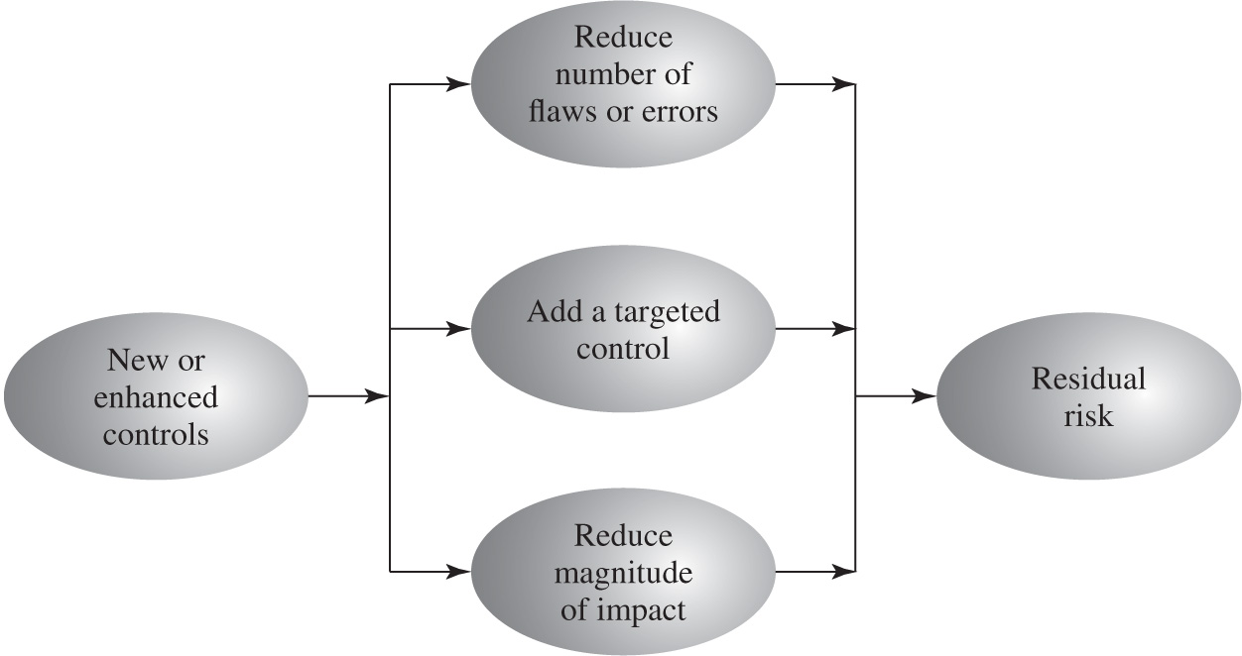
Figure 15.3 Residual Risk
Reduce Likelihood
Reduce Impact
Notes:
The reduction in level of risk that results from implementing a new or enhanced control results from the reduction in threat likelihood or consequence that the control provides, as shown in Figure 15.3. The reduction in likelihood may result either by reducing the vulnerabilities (flaws or weaknesses) in the system or by reducing the capability and motivation of the threat source. The reduction in consequence occurs by reducing the magnitude of the adverse impact of the threat occurring in the organization.

Slide 65
Cost-Benefit Analysis
Should be conducted by management to identify controls that provide the greatest benefit to the organization given the available resources
May be qualitative or quantitative
Must show cost justified by reduction in risk
Should contrast the impact of implementing a control or not, and an estimation of cost
Management chooses selection of controls
Considers if it reduces risk too much or not enough, is too costly or appropriate
Fundamentally a business decision
Notes:
The organization will likely not have the resources to implement all the recommended controls. Therefore, management should conduct a cost-benefit analysis to identify those controls that are most appropriate, and provide the greatest benefit to the organization given the available resources. This analysis may be qualitative or quantitative and must demonstrate that the cost of implementing a given control is justified by the reduction in level of risk to assets that it provides. It should include details of the impact of implementing the new or enhanced control, the impact of not implementing it, and the estimated costs of implementation. The analysis must then assess the implementation costs and benefits against system and data criticality to determine the importance of choosing this control.
Management must then determine which selection of controls provides an acceptable resulting level of risk to the organization’s systems. This selection will consider factors such as the following:
• If the control would reduce risk more than needed, then a less expensive alternative could be used.
• If the control would cost more than the risk reduction provided, then an alternative should be used.
• If a control does not reduce the risk sufficiently, then either more or different controls should be used.
• If the control provides sufficient risk reduction and is the most cost effective, then use it.
It is often the case that the cost of implementing a control is more tangible and easily specified than the cost of not implementing it. Management must make a business decision regarding these ill-defined costs in choosing the final selection of controls and resulting residual risk.

Slide 66
I T Security Plan
Provides details of:
What will be done
What resources are needed
Who is responsible
Goal is to detail the actions needed to improve the identified deficiencies in the risk profile
Should include
Risks, recommended controls, action priority
Selected controls, resources needed
Responsible personnel, implementation dates
Maintenance requirements
Notes:
Having identified a range of possible controls from which management has selected some to implement, an IT security plan should then be created, as indicated in Figures 14.1 and 15.1 . This is a document that provides details as to what will be done, what resources are needed, and who will be responsible. The goal is to detail the actions needed to improve the identified deficiencies in the organization’s risk profile in a timely manner. NIST SP 800-30 (Risk Management Guide for Information Technology Systems, September 2012) suggests that this plan should include details of:
• Risks (asset/threat/vulnerability combinations)
• Recommended controls (from the risk assessment)
• Action priority for each risk
• Selected controls (on the basis of the cost-benefit analysis)
• Required resources for implementing the selected controls
• Responsible personnel
• Target start and end dates for implementation
• Maintenance requirements and other comments

Slide 67
Table 15.4 Implementation Plan
Risk (Asset/Threat) | Hacker attack on Internet router
Level of Risk | High
Recommended Controls | Disable external telnet access Use detailed auditing of privileged command use Set policy for strong admin passwords Set backup strategy for router configuration file Set change control policy for the router configuration
Priority | High
Selected Controls | Implement all recommended controls Update related procedures with training for affected staff
Required Resources | 3 days I T net admin time to change and verify router configuration, write policies 1 day of training for network administration staff
Responsible Persons | John Doe, Lead Network System Administrator, Corporate I T Support Team
Start to End Date | February 6, 2017 to February 9, 2017
Other Comments | Need periodic test and review of configuration and policy use
Notes:
These details are summarized in an implementation plan table, such as that shown in Table 15.4 . This illustrates an example implementation plan for the example risk identified and shown in Table 14.5 . The suggested controls are specific examples of remote access, auditable event, user identification, system backup, and configuration change controls, applied to the identified threatened asset. All of them are chosen, because they are neither costly nor difficult to implement. They do require some changes to procedures. The relevant network administration staff must be notified of these changes. Staff members may also require training on the correct implementation of the new procedures and their rights and responsibilities.

Slide 68
Security Plan Implementation
I T security plan documents:
What needs to be done for each selected control
Personnel responsible
Resources and time frame
Identified personnel:
Implement new or enhanced controls
May need system configuration changes, upgrades or new system installation
May also involve development of new or extended procedures
Need to be encouraged and monitored by management
When implementation is completed management authorizes the system for operational use
Notes:
The next phase in the IT security management process, as indicated in Figure 14.1, is to manage the implementation of the controls detailed in the IT security plan. This comprises the do stage of the cyclic implementation model discussed in Chapter 14 . The implementation phase comprises not only the direct implementation of the controls as detailed in the security plan, but also the associated specific training and general security awareness programs for the organization.
The IT security plan documents what needs to be done for each selected control, along with the personnel responsible, and the resources and time frame to be used. The identified personnel then undertake the tasks needed to implement the new or enhanced controls, be they technical, managerial, or operational. This may involve some combination of system configuration changes, upgrades, or new system installation. It may also involve the development of new or extended procedures to document practices needed to achieve the desired security goals. Note that even technical controls typically require associated operational procedures to ensure their correct use. The use of these procedures needs to be encouraged and monitored by management.
The implementation process should be monitored to ensure its correctness. This is typically performed by the organizational security officer, who checks that:
• The implementation costs and resources used stay within identified bounds.
• The controls are correctly implemented as specified in the plan, in order that the identified reduction in risk level is achieved.
• The controls are operated and administered as needed.
When the implementation is successfully completed, management needs to authorize the system for operational use. This may be a purely informal process within the organization. Alternatively, especially in government organizations, this may be part of a formal process resulting in accreditation of the system as meeting required standards. This is usually associated with the installation, certification, and use of trusted computing system, as we will discuss in Chapter 27. In these cases an external accrediting body will verify the documented evidence of the correct design and implementation of the system.

Slide 69
Implementation Follow-Up
Security management is a cyclic process
Constantly repeated to respond to changes in the I T systems and the risk environment
Need to monitor implemented controls
Evaluate changes for security implications
Otherwise increase chance of security breach
Includes a number of aspects
Maintenance of security controls
Security compliance checking
Change and configuration management
Incident handling
Notes:
The IT security management process does not end with the implementation of controls and the training of personnel. As we noted in Chapter 14, it is a cyclic process, constantly repeated to respond to changes in the IT systems and the risk environment. The various controls implemented should be monitored to ensure their continued effectiveness. Any proposed changes to systems should be checked for security implications and the risk profile of the affected system reviewed if necessary. Unfortunately, this aspect of IT security management often receives the least attention and in many cases is added as an afterthought, if at all. Failure to do so can greatly increase the likelihood that a security failure will occur. This follow-up stage of the management process includes a number of aspects:
• Maintenance of security controls
• Security compliance checking
• Change and configuration management
• Incident handling
Any of these aspects might indicate that changes are needed to the previous stages in the IT security management process. An obvious example is that if a breach should occur, such as a virus infection of desktop systems, then changes may be needed to the risk assessment, to the controls chosen, or to the details of their implementation. This can trigger a review of earlier stages in the process.

Slide 70
Maintenance
Need continued maintenance and monitoring of implemented controls to ensure continued correct functioning and appropriateness
Goal is to ensure controls perform as intended
Tasks
Periodic review of controls
Upgrade of controls to meet new requirements
System changes do not impact controls
Address new threats or vulnerabilities
Notes:
The first aspect concerns the continued maintenance and monitoring of the implemented controls to ensure their continued correct functioning and appropriateness. It is important that someone has responsibility for this maintenance process, which is generally coordinated by the organization’s security officer.
The maintenance tasks include ensuring that:
• Controls are periodically reviewed to verify that they still function as intended.
• Controls are upgraded when new requirements are discovered.
• Changes to systems do not adversely affect the controls.
• New threats or vulnerabilities have not become known.
This review includes regular analysis of log files to ensure various system components are functioning as expected, and to determine a baseline of activity against which abnormal events can be compared when handling incidents. We discuss security auditing further in Chapter 18 .
The goal of maintenance is to ensure that the controls continue to perform as intended, and hence that the organization’s risk exposure remains as chosen. Failure to maintain controls could lead to a security breach with a potentially significant impact on the organization.

Slide 71
Security Compliance
Audit process to review security processes
Goal is to verify compliance with security plan
Use internal or external personnel
Usually based on use of checklists which verify:
Suitable policies and plans were created
Suitable selection of controls were chosen
That they are maintained and used correctly
Often as part of wider general audit
Notes:
Security compliance checking is an audit process to review the organization’s security processes. The goal is to verify compliance with the security plan. The audit may be conducted using either internal or external personnel. It is generally based on the use of checklists, which verify that the suitable policies and plans have been created, that suitable controls were chosen, and that the controls are maintained and used correctly.
This audit process should be conducted on new IT systems and services once they are implemented; and on existing systems periodically, often as part of a wider, general audit of the organization or whenever changes are made to the organization’s security policy.

Slide 72
Change and Configuration Management
Change management is the process to review proposed changes to systems
Evaluate the impact
Important component of general systems administration process
Test patches to make sure they do not adversely affect other applications
May be informal or formal
Configuration management is specifically concerned with keeping track of the configuration of each system in use and the changes made to them
Keep lists of hardware and software versions installed on each system to help restore them following a failure
Know what patches or upgrades might be relevant
Also part of general systems administration process
Notes:
Change management is the process used to review proposed changes to systems for implications on the organization’s systems and use. Changes to existing systems can occur for a number of reasons, such as the following:
• Users reporting problems or desired enhancements
• Identification of new threats or vulnerabilities
• Vendor notification of patches or upgrades to hardware or software
• Technology advances
• Implementation of new IT features or services, which require changing existing systems
• Identification of new tasks, which require changing existing systems
The impact of any proposed change on the organization’s systems should be evaluated. This includes not only security-related aspects, but wider operational issues as well. Thus change management is an important component of the general systems administration process. Because changes can affect security, this general process overlaps IT security management and must interact with it.
An important example is the constant flow of patches addressing bugs and security failings in common operating systems and applications. If the organization is running systems of any complexity, with a range of applications, then patches should ideally be tested to ensure that they don’t adversely affect other applications. This can be a time-consuming process that may require considerable administration resources, and could leave the organization exposed to a new vulnerability for a period. Otherwise, the patches or upgrades could be applied without testing, which may possibly result in other failures in the systems and the loss of functionality, but will also improve system security due to faster patching. Management need to decide whether availability or security has higher priority in such cases.
Ideally, most proposed changes should act to improve the security profile of a system. However, it is possible that for imperative business reasons a change is proposed that reduces the security of a system. In cases like this, it is important that the reasons for the change, its consequences on the security profile for the organization, and management authorization of it be documented. The benefits to the organization would need to be traded off against the increased risk level.
The change management process may be informal or formal, depending on the size of the organization and its overall IT management processes. In a formal process, any proposed change should be documented and tested before implementation. As part of this process, any related documentation, including relevant security documentation and procedures, should be updated to reflect the change.
Configuration management is concerned with specifically keeping track of the configuration of each system in use and the changes made to each. This includes lists of the hardware and software versions installed on each system. This information is needed to help restore systems following a failure (whether security related or not) and to know what patches or upgrades might be relevant to particular systems. Again, this is a general systems administration process with security implications and must interact with IT security management.

Slide 73
Case Study: Silver Star Mines
Given risk assessment, the next stage is to identify possible controls
Based on assessment it is clear many categories are not in use
General issue of systems not being patched or upgraded
Need contingency plans
S C A D A: add intrusion detection system
Info integrity: better centralize storage
Email: provide backup system
Notes:
Consider the case study introduced in Chapter 14, which involves the operations of a fictional company Silver Star Mines. Given the outcome of the risk assessment for this company, the next stage in the security management process is to identify possible controls. From the information provided during this assessment, clearly a number of the possible controls listed in Table 15.3 are not being used. A comment repeated many times was that many of the systems in use had not been regularly upgraded, and part of the reason for the identified risks was the potential for system compromise using a known but unpatched vulnerability. That clearly suggests that attention needs to be given to controls relating to the regular, systematic maintenance of operating systems and applications software on server and client systems. Such controls include
• Configuration management policy and procedures
• Baseline configuration
• System maintenance policy and procedures
• Periodic maintenance
• Flaw remediation
• Malicious code protection
• Spam and spyware protection
Given that potential incidents are possible, attention should also be given to developing contingency plans to detect and respond to such incidents and to enable speedy restoration of system function. Attention should be paid to controls such as
• Audit monitoring, analysis, and reporting
• Audit reduction and report generation
• Contingency planning policy and procedures
• Incident response policy and procedures
• Information system backup
• Information system recovery and reconstitution
These controls are generally applicable to all the identified risks and constitute good general systems administration practice. Hence, their cost effectiveness would be high because they provide an improved level of security across multiple identified risks.
Now consider the specific risk items. The top-priority risk relates to the reliability and integrity of the Supervisory Control and Data Acquisition (SCADA) nodes and network. These were identified as being at risk because many of these systems are running older releases of operating systems with known insecurities. Further, these systems cannot be patched or upgraded because the key applications they run have not been updated or validated to run on newer O/S versions. Given these limitations on the ability to reduce the vulnerability of individual nodes, attention should be paid to the firewall and application proxy servers that isolate the SCADA nodes and network from the wider corporate network. These systems can be regularly maintained and managed according to the generally applied list of controls we identified. Further, because the traffic to and from the SCADA network is highly structured and predictable, it should be possible to implement an intrusion detection system with much greater reliability than applies to general-use corporate networks. This system should be able to identify attack traffic, as it would be very different from normal traffic flows. Such a system might involve a more detailed, automated analysis of the audit records generated on the existing firewall and proxy server systems. More likely, it could be an independent system connected to and monitoring the traffic through these systems. The system could be further extended to include an automated response capability, which could automatically sever the network connection if an attack is identified. This approach recognizes that the network connection is not needed for the correct operation of the SCADA nodes. Indeed, they were designed to operate without such a network connection, which is much of the reason for their insecurity. All that would be lost is the improved overall monitoring and management of the SCADA nodes. With this functionality, the likelihood of a successful attack, already regarded as very unlikely, can be further reduced.
The second priority risk relates to the integrity of stored information. Clearly all the general controls help ameliorate this risk. More specifically, much of the problem relates to the large number of documents scattered over a large number of systems with inconsistent management. This risk would be easier to manage if all documents identified as critical to the operation of the company were stored on a smaller pool of application and file servers. These could be managed appropriately using the generally applicable controls. This suggests that an audit of critical documents is needed to identify who is responsible for them and where they are currently located. Then policies are needed that specify that critical documents should be created and stored only on approved central servers. Existing documents should be transferred to these servers. Appropriate education and training of all affected users is needed to help ensure that these policies are followed.
The next three risks relate to the availability or integrity of the key Financial, Procurement, and Maintenance/Production systems. The generally applicable controls we identified should adequately address these risks once the controls are applied to all relevant servers.
The final risk relates to the availability, integrity, and confidentiality of e-mail. As was noted in the risk assessment, this is primarily the responsibility of the parent company’s IT group that manages the external mail gateway. There is a limited amount that can be done on the local site. The use of the generally applicable controls, particularly those relating to malicious code protection and spam and spyware protection on client systems, will assist in reducing this risk. In addition, as part of the contingency planning and incident response policies and procedures, consideration could be given to a backup e-mail system. For security this system would use client systems isolated from the company intranet, connected to an external local network service provider. This connection would be used to provide limited e-mail capabilities for critical messages should the main company intranet e-mail system be compromised.

Slide 74
Table 15.5 Silver Star Mines: Implementation Plan
Risk (Asset/Threat) | Level of Risk | Recommended Controls | Priority | Selected Controls
All risks (generally applicable) | Blank | Configuration and periodic maintenance policy for servers Malicious code (S P A M, spyware) prevention Audit monitoring, analysis, reduction, and reporting on servers Contingency planning and incident response policies and procedures System backup and recovery Procedures | 1 | 1. 2. 3. 4. 5.
Reliability and integrity of S C A D A nodes and network | High | Intrusion detection and response system | 2 | 1.
Integrity of stored file and database information | Extreme | Audit of critical documents Document creation and storage policy User security education and Training | 3 | 1. 2. 3.
Availability and integrity of Financial, Procurement, and Maintenance/ Production Systems | High | Blank | Blank | (general controls)
Availability, integrity, and confidentiality of e-mail | High | Contingency planning—backup e-mail service | 4 | 1.
Notes:
This analysis of possible controls is summarized in Table 15.5 , which lists the controls identified and the priorities for their implementation. This table must be extended to include details of the resources required, responsible personnel, time frame, and any other comments. This plan would then be implemented, with suitable monitoring of its progress. Its successful implementation leads then to longer term follow-up, which should ensure that the new policies continue to be applied appropriately and that regular reviews of the company’s security profile occur. In time this should lead to a new cycle of risk assessment, plan development, and follow-up.

Slide 75
Incident Management – ISO 27002
Report – Capture All relevant information
Investigation
Assessment
Corrections
Review

Slide 76
Incident Management – ISO 27002
Report – Capture All relevant information
Time, location, responder, asset, description, impact, actions taken
Investigation
Assessment
Corrections
Review

Slide 77
Incident Management – ISO 27002
Report – Capture All relevant information
Investigation
Collection of Evidence
Analysis of Evidence
Forensics Procedures
Assessment
Corrections
Review

Slide 78
Incident Management – ISO 27002
Report – Capture All relevant information
Investigation
Assessment
Review and make a decision
Keep as single event
Raise to security incident
Trigger Response Procedures
Log Decisions and actions
Corrections
Review

Slide 79
Incident Management – ISO 27002
Report – Capture All relevant information
Investigation
Assessment
Corrections
Apply actions to mitigate incident
Examples:
Backups
Turn on servers
Perform remote wipe
Corrective actions should be logged
Review

Slide 80
Incident Management – ISO 27002
Report – Capture All relevant information
Investigation
Assessment
Corrections
Review
Check actions are being implemented
Review controls and processes that failed
Update and trigger processes

Slide 81
Incident Management – ISO 27002
Business continuity plan
Prioritize correction phase over other phases
Top priority is to keep business running
Triggered by severe incidents

Slide 82
Summary
I T security management implementation
Security controls or safeguards
I T security plan
Implementation of controls
Implementation of security plan
Security awareness and training
Monitoring risks
Maintenance
Security compliance
Change and configuration management
Incident handling
Case study: Silver Star Mines
Notes:
Chapter 15 summary.

